Slide 1
libtimecourse: A Matlab toolbox for neural data analysis
HyungGoo Kim
Uchida Lab

Slide 2
In a nutshell: what you can do with libtimecourse

Slide 3

Data
Trial start
Water reward
Licking
Running speed
Extracellular spike
Ca²⁺ (GCaMP)
Intracellular Vm
0
Time (ms)
Timestamp signals
Task event (e.g., stimulus onset), behavioral events (e.g., licking) or neural activity (e.g., single unit spike)
Time in millisecond from session start (0 ms)
Continuous signals
Sampled at 1000Hz (1ms bin) from session start (0 ms)

Slide 4
Motivation
Provide a set of functions that allow users to manage data flexibly, rigorously, and easy to verify the results.
This helps the users avoid spending time on
Verifying basic properties (e.g., alignment on the trigger) of PSTHs
Combining PSTHs and aligning time series across different PSTHs
Checking whether some experimental groups are missing
Dealing with errors in ‘basic but essential’ data processing parts.
Users can focus on their own scientific questions
E.g., what does the multi-dimensional population activity mean?

Slide 5
Design principle
Single-session plot
Show individual trials and average PSTH
Variable time window (e.g., reaction-time tasks)
Sort trials by experimental conditions
Sort trials by an event of interest
Statistical test
Save the PSTHs with all the relevent (e.g., group, timing, event) information
Population plot
Manage multiple PSTHs easily
Combine different time range
Check integrity of experimental conditions across sessions

Slide 6
plot_timecourse(): plotting PSTH
Download and install
Go to http://
Click ‘save’
Open Matlab
>> load libtimecourse_demo_data
>> figure;
>> plot_timecourse(‘timestamp’, ms_lick, ms_reward, -2000, 2000);
Features
One function for both timestamp and continuous data
Time window can be either constant or variable
Show N for every plot
Supports simple stats
easy to save, load, and combine

Slide 7
Plot_timecourse: sort

Slide 8
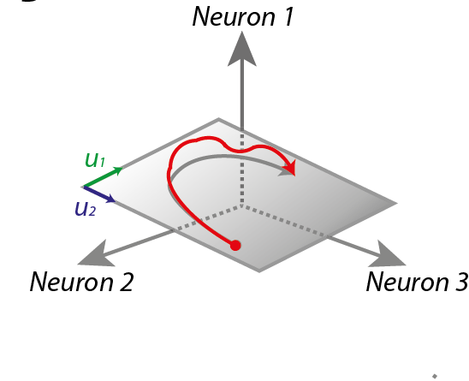
Single unit and Population dynamics
Batch processing of
Single units
Load data
Analyze (e.g., orientation
selectivity index)
Save numbers
Population Data
Population Analysis

Slide 9
Cognitive process of single-unit analysis
Hypothesis (or just do assumption-free experiments)
Repeat until you have N conclusions (e.i., figures)
Plot results by events of interest
Look at the results carefully
Make a quantitatively testable hypothesis
Quantify responses
Population analysis
Prove or disprove the hypothesis by statistical tests
Do modeling if necessary
Present
Write
Fun
IF
If you can look at data fast, flexibly
Examine population easily with stats
Otherwise,
Projects will be delayed
Conclusion can be wrong

Slide 10
Population analysis
Extract numbers from PSTHs
Within-session analysis (across trials)
Across-session analysis (using session-average, across session)
Visualization accompanies stats
Rigorous
N, OL

Slide 11
Disclaimer
Bugs will happen; suspect the results!

